Slide 1
Smart contracts for supply chain management
Miulescu Cristina-Maria, SCPD

Slide 2
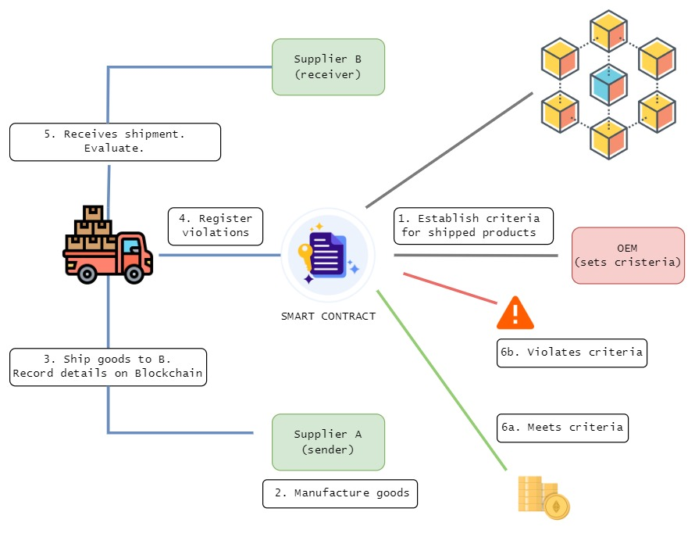
MAIN IDEA
Improve the Supply Chain Management through the use of smart contracts:
Traceability – allows inventory tracking

Slide 3
Related work
Crypto Cargo
Blockchain based container that continuously monitors the container for any violations that may endanger its contents.
Does not address end-to-end communication between stakeholders in the shipping procedure

Slide 4
Implementation steps
1. Smart Contract
2. Container Simulator
3. Customer Platform

Slide 5
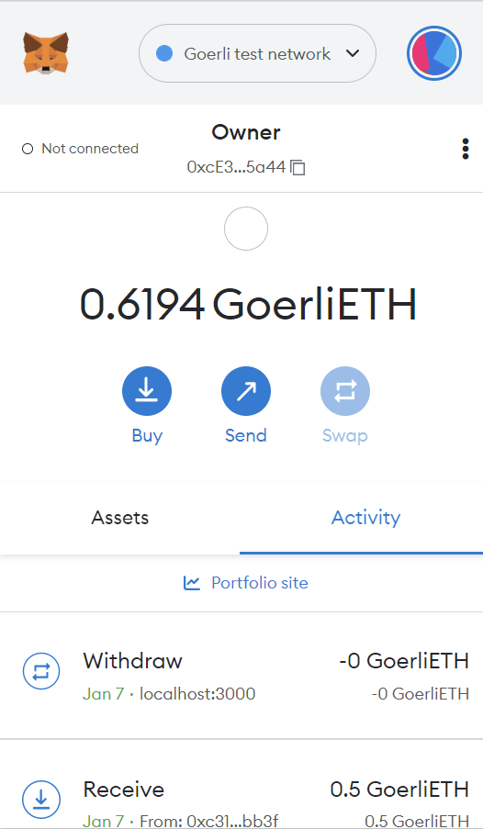
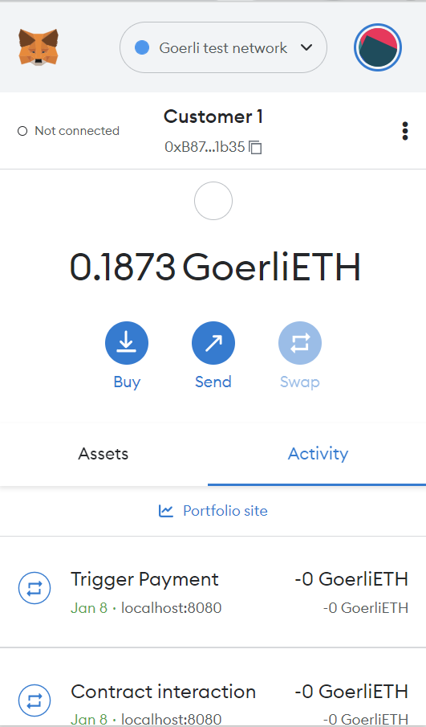
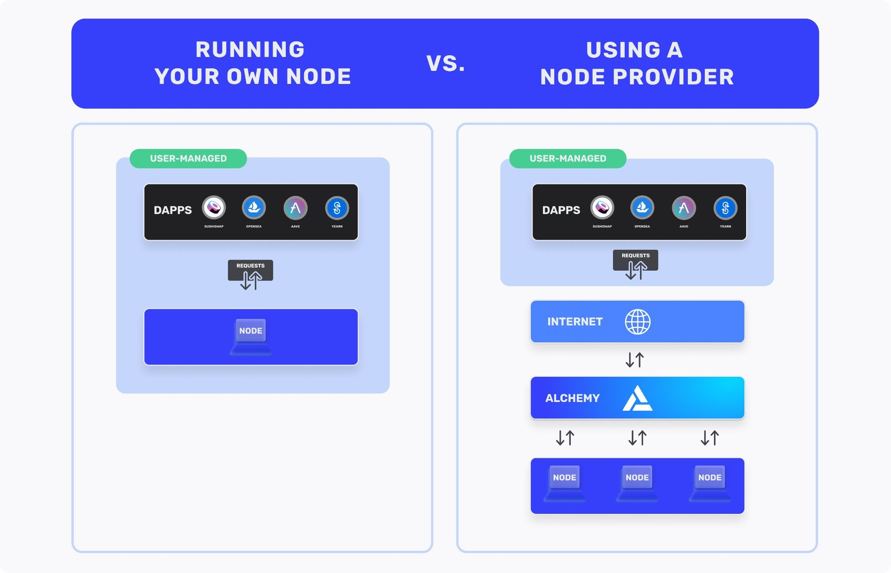
1. Smart contract
Metamask Wallet (Client side)
Alchemy Node Provider (Simulator)
Access Blockchain without running a local node

Slide 6
1. Smart contract implementation
Ownable.sol
SupplyChainManagement.sol

Slide 7
Ownable contract
The deployer of the contract is the owner
The onlyOwner modifier prevents other accounts to execute specific functions:
function triggerDelivery(uint _containerId) public onlyOwner { ... }
Note: The simulated container will use the owner account to register the violations that may occur
// SPDX-License-Identifier: MIT
pragma solidity >=0.8.17;
contract Ownable {
address payable _owner;
constructor() {
_owner = payable(msg.sender);
}
modifier onlyOwner() {
require(isOwner(), "You are not the owner");
_;
}
function isOwner() public view returns(bool) {
return (msg.sender == _owner);
}
}

Slide 8
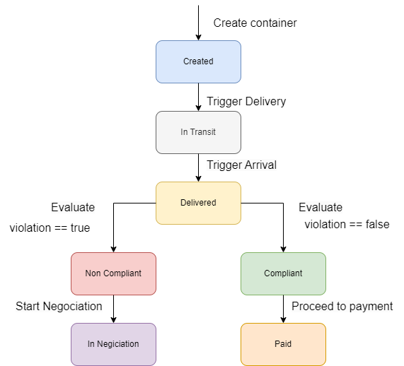
Supply chain management contract
struct ShippingContainer {
string _productName;
uint _price;
uint _quantity;
address _customerAddress;
DeliveryState _deliveryState;
ViolationState _violationState;
}
mapping(uint => ShippingContainer) public containers;
Events:
event DeliveryStateChanged(uint _containerIndex, uint _deliveryState);
event ViolationStateChanged(uint _containerIndex, uint violationState)

Slide 9
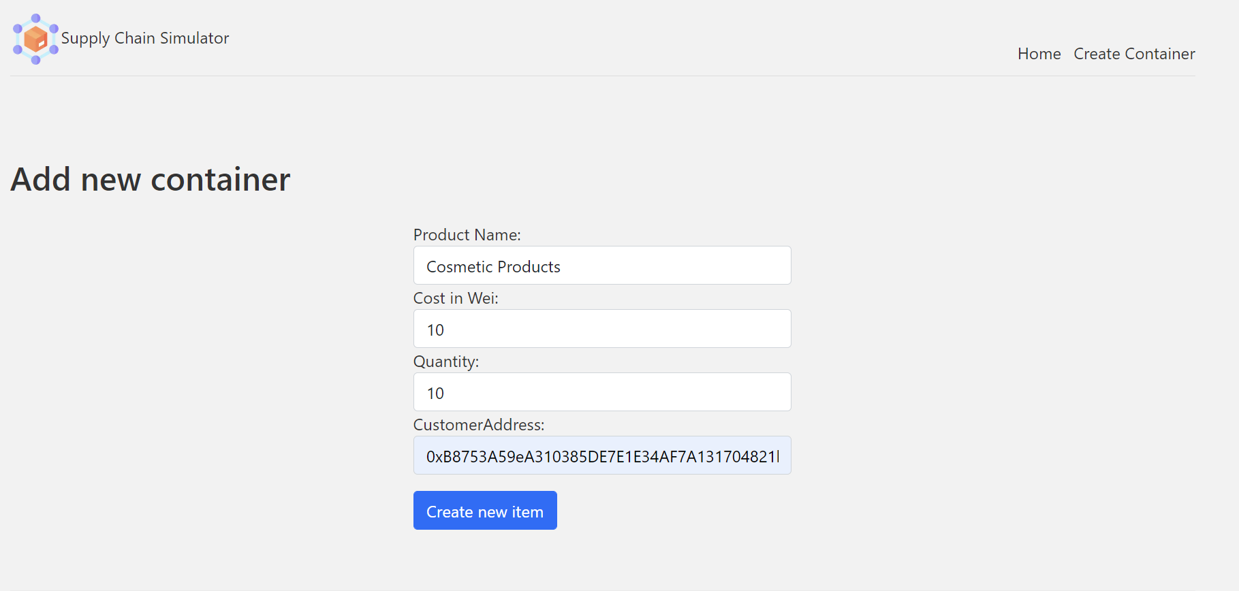




2. Container simulator

Slide 10
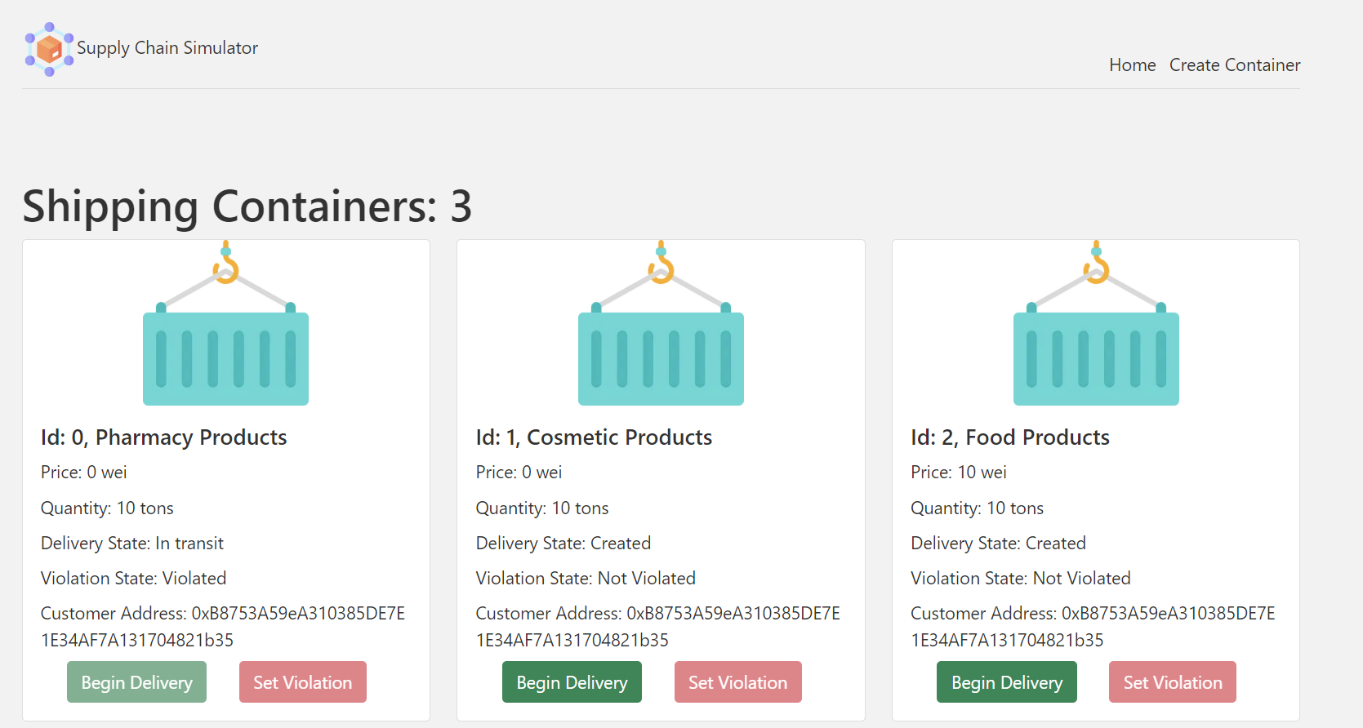
2. Container simulator

Slide 11
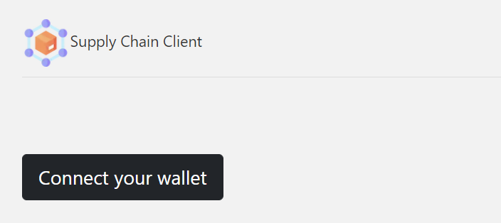
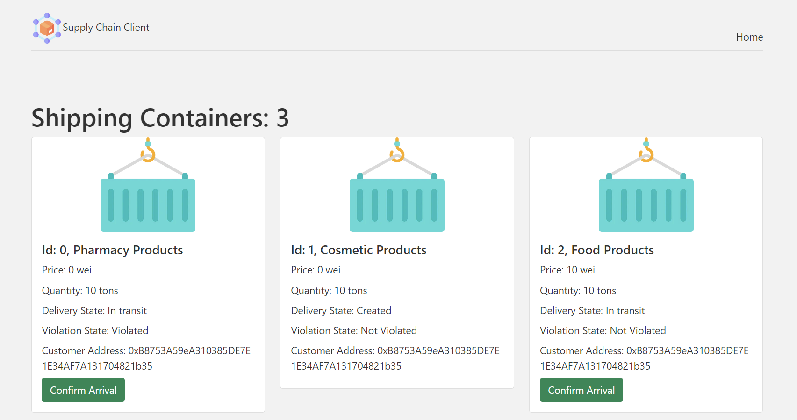
3. Client platform

Slide 12
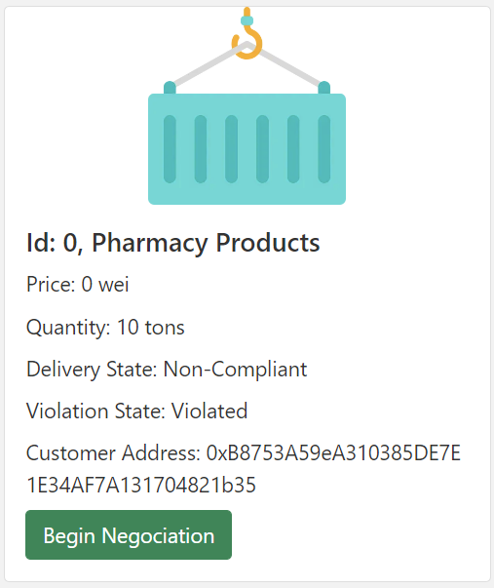
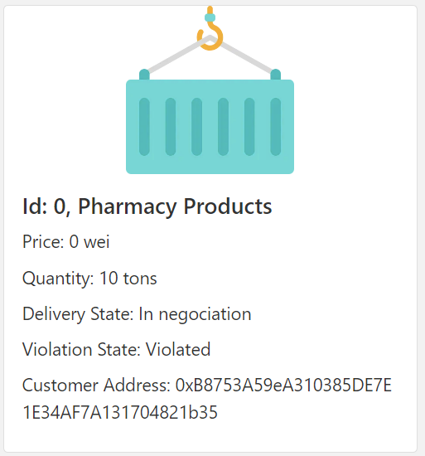
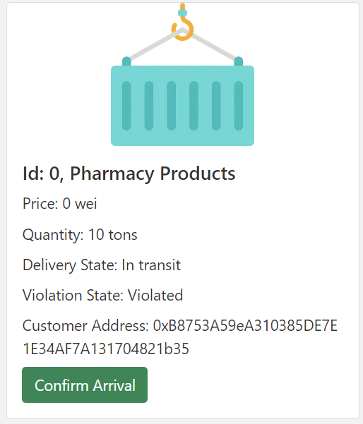
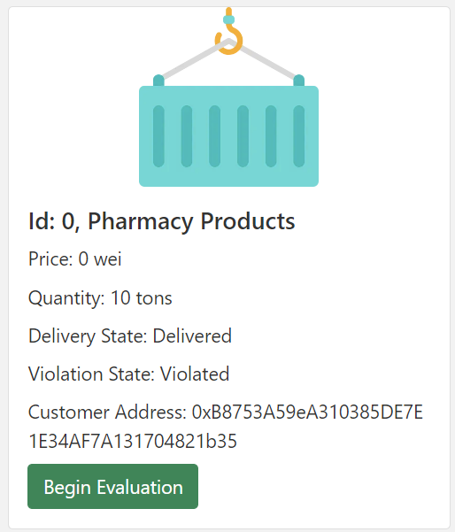
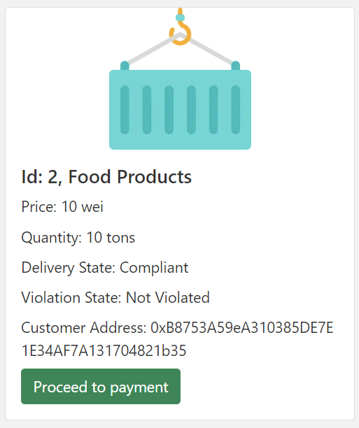
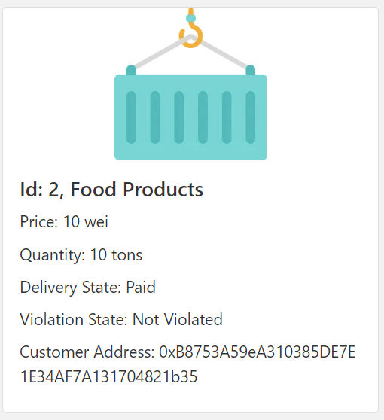
3. Client platform

Slide 13
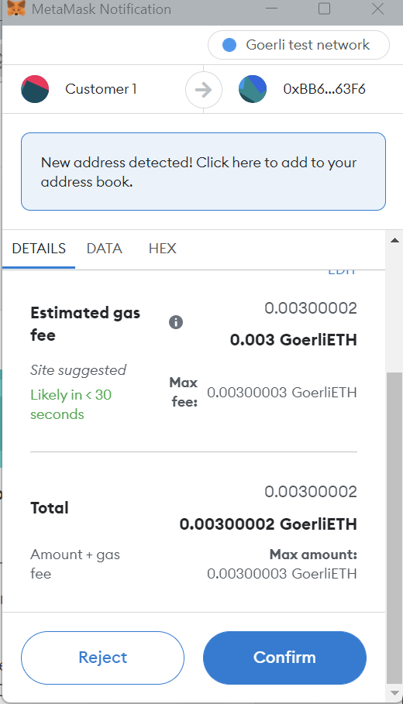
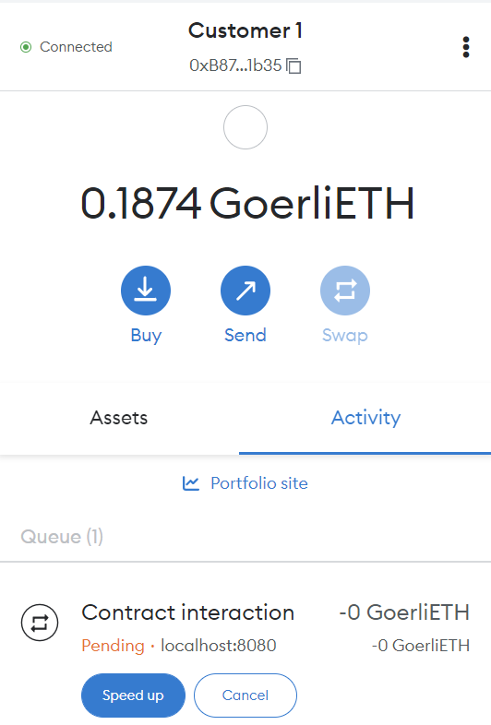

3. Client platform metamask interaction

Slide 14
Further improvements
Define violation types that may occur (container lid open, GPS location, delayed delivery etc.)
Handle the negociation stage (ex: send email to the owner)

Slide 15
conclusion
Blockchain based solution which offers:
containers traceability in a decentralized and transparent manner.
a way to handle non-compliant delivery

